Slide 1

Developer tools

Slide 2
Why use tools?
You can create software/analysis without using developer tools…
… but you will be very unpopular!
Developer tools are tools that make the development process smoother, particularly when working in a team.
VERY beneficial skills to have under your belt as a developer.
Often new projects will use these tools and expect you to know how to use them.

Slide 3
Examples where these tools are useful
You make numerous changes to a project, only to realize what you are doing is wrong, and need to roll back to a previous version.
You have a number of people working on different features of a project and need these features to be added to the project asynchronously without disrupting other work.
You are releasing a project that requires a specific configuration of Python packages/computer setup to work.

Slide 4
VERSION CONTROL
Version control refers to any system that records changes to a file.
The simplest version control system is just saving a new copy of your work to an “archive” folder so you can roll back to a previous version if something goes wrong.
However, when a team is working on multiple projects, these version will quickly diverge and there’s no easy way of merging them together without a headache!

Slide 5
VERSION CONTROL
A system like git works by allowing multiple “branches” of a project to exist, with mechanisms to split branches to account for different feature projects.
When a feature is ready to be integrated back into its previous branch, it can be merged easily by comparing the differences between the branches.

Slide 6

VERSION CONTROL example

Slide 7
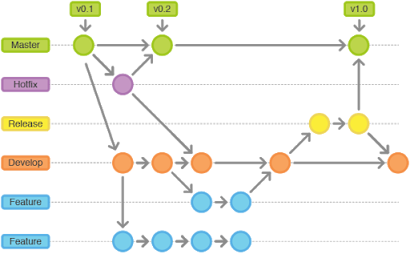
VERSION CONTROL in practice

Slide 8
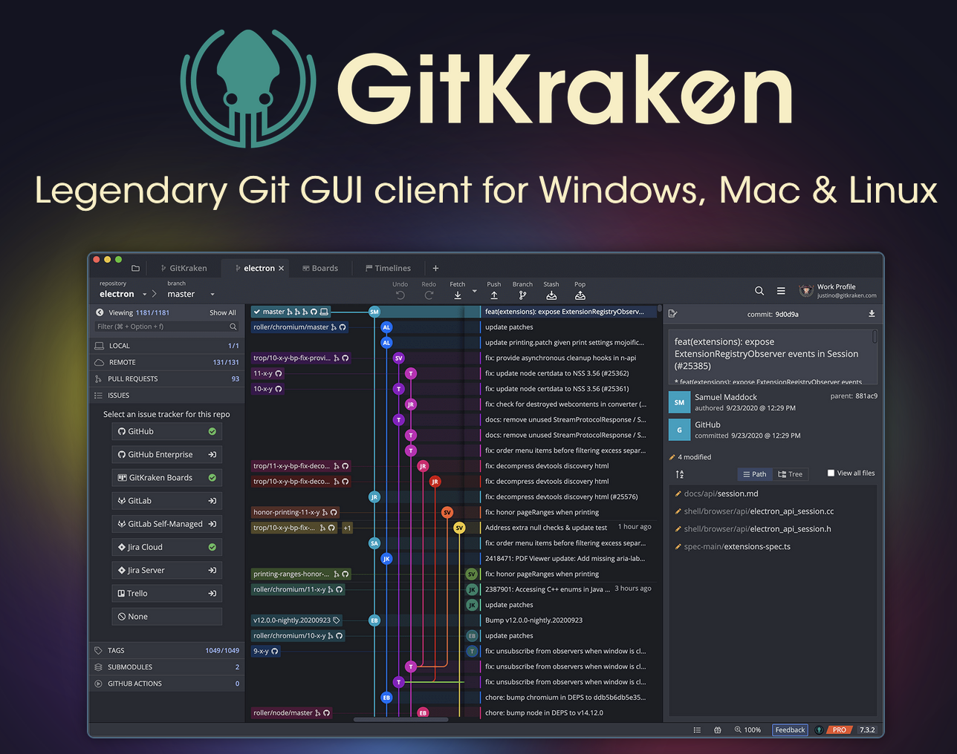
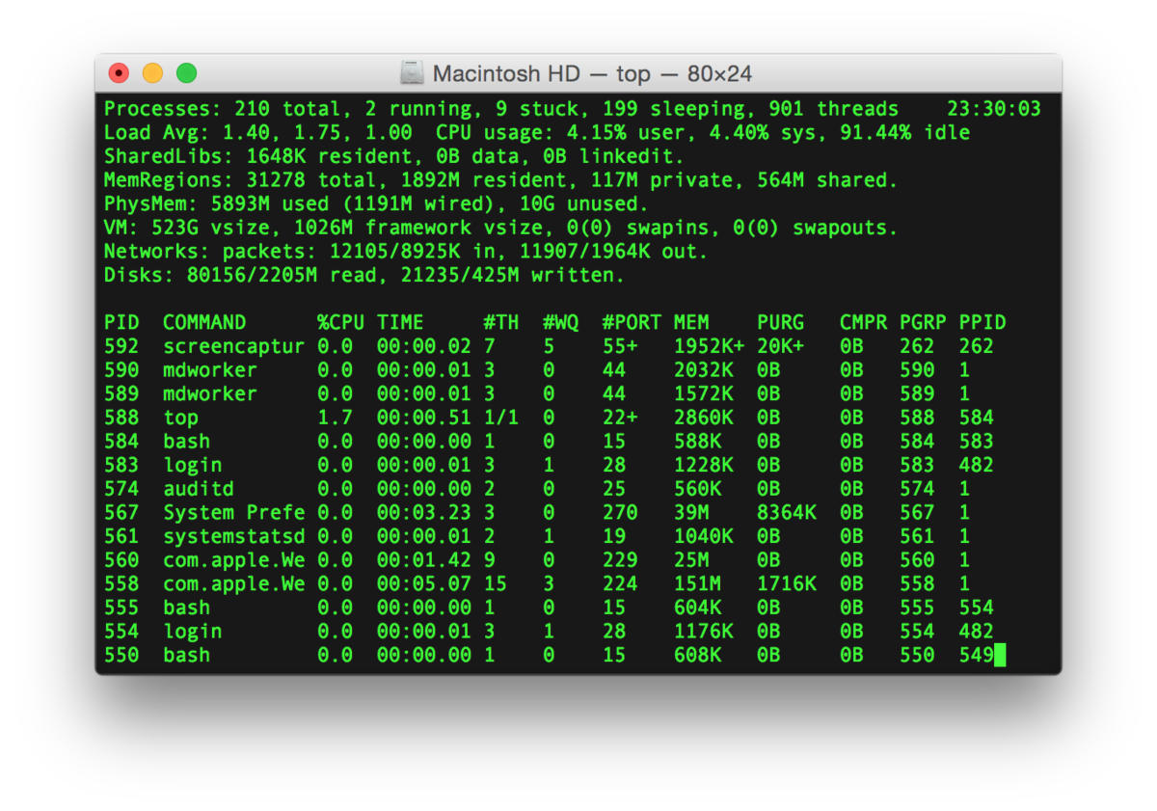
So how does this work in practice?

Slide 9
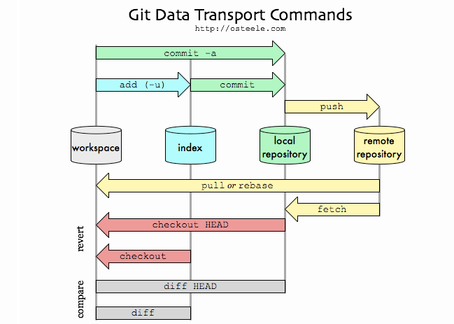
So how does this work in practice?

Slide 10
Virtual environments
Virtual environments are a way of separating your programming environments from your other environments.
Each virtual environment has a version of Python, and a set of installed packages.
Many options – pip, conda, poetry, venv, pipenv, all with different but similar syntax.
Is very important for publishing your work – you should be able to tell people to enter a virtual environment instead of giving them a list of packages to install.

Slide 11
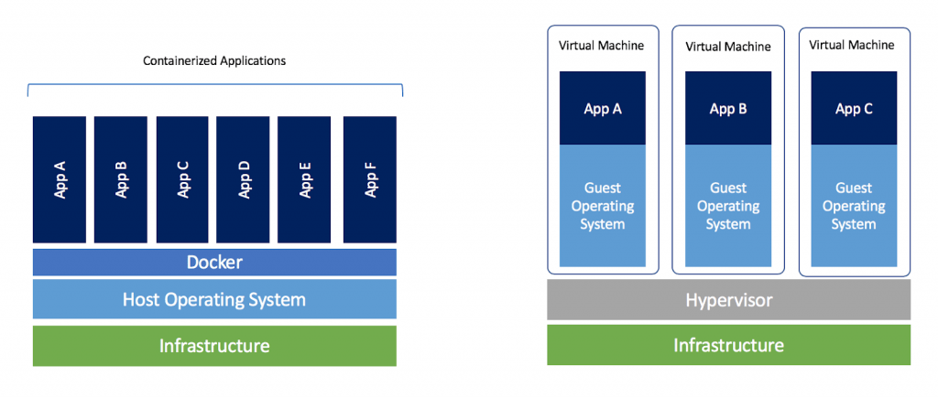
Virtual environments
Env A
Env B
Env C
Env D
Python
Python Virtual Environments
Virtual Machines (whole OS)
Docker (whole OS)

Slide 12
Other very important tools
Distributed computing tools (Spark, etc.)
ssh, smtp, “linux-y stuff”
Testing (very important!)
CI/CD

